Slide 1


Urdu Back Translation Text Reuse Detection
Supervisor : Dr Muhammad Sharjeel
Malik Ashas Abbas | Umer Amir | Usama Tufail

Slide 2
Introduction
UTRD Importance
UTRD Challenges
TABLE OF CONTENTS
Existing Work Limitations
Objectives
Methodology
Summary

Slide 3
Introduction
1
Text reusing involves rephrasing text to express the same meaning with different wording or sentence structure.
2
In NLP, text reuse detection is the process of determining if two segments convey the same meaning.

Slide 4
Urdu Text Reuse Detection Importance
1
Academic Integrity
2
Content Rewriting
3
Legal Aspects
4
Translation Analysis
Notes:
University of Punjab. Agha Khan
BBC URDU Legal Aspects Translation Analysis M.A Urdu 70
M.Phil Urdu 35
Ph.D. Urdu 15

Slide 5
Urdu Text Reuse Detection Challenges
1
Linguistic Complexity
2
Spelling Variations
3
Limited Data Resources
4
Use of Metaphors and Idioms
Notes:
Lexical Morphological
Semantic level
Arabic script, and there are often multiple ways to write the same word due to different regional spellings or phonetic variations.
limited availability of labeled data and corpora specifically for the Urdu language

Slide 6
Limitations of Existing Work
1
Small Dataset
2
Methodological Constraints
Notes:
USTRC 2648
Counter 1200 pair

Slide 7
01
Corpus Generation
Objective
02
Develop Urdu Text Reuse
Detection Classifiers
03
Web Application

Slide 8






Methodology
1
3
5
Evaluation
Corpus Generation
Feature
Engineering
2
4
6
Preprocessing
Web Application
Experimentation

Slide 9
Corpus Generation
1
We used the COUNTER corpus, which contains 1,200 journalism documents manually annotated with three levels of text reuse: WD, PD, and ND.
2
From the COUNTER corpus, we extracted 600 derived documents.
3
These 600 documents were translated using back translation.
4
For language families, we selected four: Latin, Arabic, Indo-Aryan, and Afroasiatic.
5
For the most spoken languages, we selected nine: Arabic, Chinese, Spanish, English, Hindi, Bengali, Portuguese, Japanese, and Punjabi.
Notes:
Berlitz for selecting top nine lanague
Top Nine Most Spoken Languages (2025 Estimates)
English – 1.52 billion speakers (native + non-native)
Mandarin Chinese – 1.12 billion speakers
Hindi – 609 million speakers
Spanish – 559 million speakers
Modern Standard Arabic – 332 million speakers
French – 312 million speakers
Bengali – 278 million speakers
Portuguese – 264 million speakers
Russian – 255 million speakers
Latin (Romance Language Family):
Spanish
Portuguese
French
Arabic (Afro-Asiatic Language Family):
Arabic
Amharic
Somali
Indo-Aryan (Indo-European Family):
Hindi
Bengali
Punjabi
Afroasiatic (Semitic Branch):
Arabic
Hebrew
Amharic

Slide 10
Corpus Generation
1
Five corpora are based on Urdu paired with the top 1, 3, 5, 7, and 9 most spoken languages, respectively.
2
Four corpora are created by translating Urdu through languages from four different culturally diverse language families (Latin, Arabic, Indo-Aryan, and African) and then back to Urdu.

Slide 11

Corpus Demography
Counter Corpus:
Generated Corpus:
PD
Partially Derived
PD
Partially Derived
Number of instances : 288
Number of instances : 2,592
WD
Wholly Derived
WD
Wholly Derived
Number of instances : 135
Number of instances : 1,593
ND
Non Derived
ND
Non Derived
Number of instances : 177
Number of instances : 177
Scale & Diversity : 9x larger than the COUNTER corpus.
Notes:
Gold Standard Datasets Manual Annotation by Experts
High Quality and Reliability:
Feature: Gold standard datasets consistently have high data quality. The annotations are accurate, precise, and not ambiguous.
Consistency and Standardization:
Feature: The dataset is annotated according to a standardized set of rules

Slide 12
Preprocessing
Effective pre-processing was essential to handle the complex structure and morphology of Urdu. We used the LughaatNLP library for Urdu text preprocessing.
1
Cleaning: Removed special characters, diacritics, punctuation, and extra white spaces
2
Lemmatization: Converted words to their base forms to normalize variations.
3
Stemming: Reduced words to their root forms to unify related terms.
Notes:
Stemming vs Lemmatization (with Examples)
Stemming is a fast, rule-based technique that chops off word endings to get the root form, but the result may not be a real word. Lemmatization is more accurate — it uses a dictionary and grammar rules to find the proper base form (lemma) of a word.
🔹 Example in English:
Stemming: studies → studi ❌ (not a valid word)
Lemmatization: studies → study ✅
🔹 Example in Urdu:
Stemming: دوڑتا, دوڑی → دوڑ ❌
Lemmatization: دوڑتا, دوڑی → دوڑنا ✅

Slide 13
Preprocessing
1
Global Preprocessing
2
Class-wise Preprocessing

Slide 14
Feature Engineering
1
Sentence Bert (LABSE) Based Feature Extraction
2
Deep Learning Based Features Extraction

Slide 15
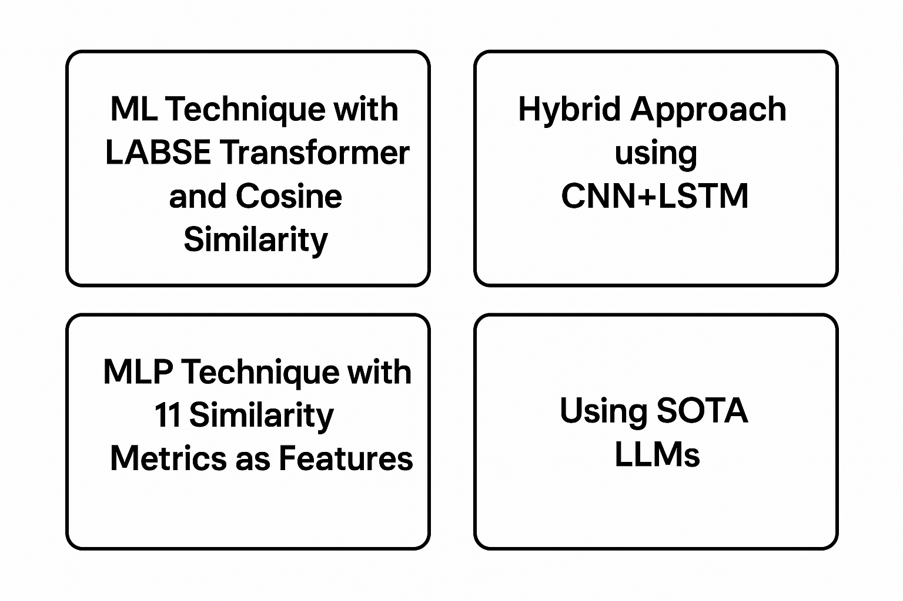
Experimentation

Slide 16

ML Technique with LABSE transformer and Cosine similarity
LABSE
(768)
Calculate
Cosine
Similarity
Train ML classifiers
KNN, SVM, RF, DT
Evaluate results
Source
text
LABSE
(768)
Derived
text

Slide 17
ML Technique with LABSE transformer and
Cosine similarity
Models - 3 Class (PD, WD, ND) | F1-Score
Counter Corpus | 51.23 %
Language 1 | 48.99 %
Language 3 | 44.68 %
Language 5 | 42.75 %
Language 7 | 45.09 %
Language 9 | 43.38 %
Afrosiatic | 46.47 %
Aryan | 47.21 %
Germanic | 48.22 %
Latin | 47.25 %

Slide 18
ML Technique with LABSE transformer and
Cosine similarity
Models - 2 Class (PD, ND) | F1-Score
Counter Corpus | 60.53 %
Language 1 | 59.82 %
Language 3 | 58.72 %
Language 5 | 56.91 %
Language 7 | 56.79 %
Language 9 | 54.93 %
Afrosiatic | 56.41 %
Aryan | 59.82 %
Germanic | 60.8 %
Latin | 56.41 %

Slide 19
Hybrid Approach using CNN+LSTM
CNN
(bigram)
Combine
Combine
Dense
Layers
LABSE
(768)
LSTM
CNN
(trigram)
Source
text
CNN
(bigram)
Combine
LABSE
(768)
LSTM
CNN
(trigram)
Derived
text

Slide 20

Hybrid Approach using CNN+LSTM
Models | F1-Score (3 Class)
Using LABSE Sentence transformer | 48.76 %
Using multilingual e5 large sentence transformer | 47.41 %
Using multilingual e5 large instruct sentence transformer | 48 %
Using Xlm multilingual v1 | 47.73 %
Note:
Best multilingual sentence transformer for to generate Embedding for Urdu language is LABSE

Slide 21
MLP technique with 11 similarity metrics as features
LABSE
(768)
Calculate
Cosine
Similarity, Euclidean, Manhattan, Minkowski, Pearson, Spearman, Bray, Jaccard, Hamming, Curtis
Train
Classifier
Evaluate results
Source
Text
LABSE
(768)
Derived
Text
Notes:
Distance & Similarity Metrics – Slide Notes
Cosine Similarity Measures the angle between vectors (ignores magnitude). Formula: cos(θ) = A·B / (‖A‖ × ‖B‖) Example: A=[1,2], B=[4,6] → Cosine ≈ 0.983
Euclidean Distance (L2) Straight-line distance in space. Formula: √Σ(xᵢ − yᵢ)² Example: √((4−1)² + (6−2)²) = 5
Manhattan Distance (L1) Sum of absolute differences (grid-walk). Formula: Σ|xᵢ − yᵢ| Example: |1−4| + |2−6| = 7
Minkowski Distance Generalized form of L1/L2 (p=1 → Manhattan, p=2 → Euclidean). Formula: (Σ|xᵢ − yᵢ|^p)^(1/p) Example: p=3 → ≈ 4.497
Pearson Correlation Measures linear relationship (values must vary linearly). Range: -1 to 1 Example: A=[1,2,3], B=[4,5,6] → Pearson = 1
Spearman Rank Correlation Measures rank-based (monotonic) correlation. Example: Same ranks → Spearman = 1
Bray-Curtis Dissimilarity Used in ecology; compares abundance. Formula: Σ|xᵢ − yᵢ| / Σ(xᵢ + yᵢ) Example: ≈ 0.428Jaccard Similarity Measures overlap between two sets. Formula: |A ∩ B| / |A ∪ B| Example: A={1,2,3}, B={2,3,4} → Jaccard = 0.5
Hamming Distance Counts differing positions in binary strings. Example: A="101", B="100" → Distance = 1
Canberra Distance Weighted version of Manhattan; sensitive to small values. Formula: Σ(|xᵢ − yᵢ| / (|xᵢ| + |yᵢ|)) Example: ≈ 1.178
Curtis Dissimilarity Another name for Bray-Curtis (same formula and use).

Slide 22
MLP technique with 11 similarity metrics as features
Models - 3 Class (PD, WD, ND) | F1-Score
Counter Corpus | 79.48 %
Language 1 | 75.99 %
Language 3 | 72.78 %
Language 5 | 73.54 %
Language 7 | 73.73 %
Language 9 | 72.49 %
Afrosiatic | 72.52 %
Aryan | 75.29 %
Germanic | 78.03 %
Latin | 75.81 %

Slide 23
MLP technique with 11 similarity metrics as features
Models - 2 Class (PD, ND) | F1-Score
Counter Corpus | 96.13 %
Language 1 | 95.03 %
Language 3 | 94.38 %
Language 5 | 93.65 %
Language 7 | 93.77 %
Language 9 | 94.66 %
Afrosiatic | 94.88 %
Aryan | 94.39 %
Germanic | 95.61 %
Latin | 95.59 %

Slide 24
Using SOTA LLM’s
Prompt
+
(Source Text
+
Derived Text)
Source
Text
LLM
Evaluate
Result
Derived
Text

Slide 25
Using SOTA LLM’s
1
We conducted a one-shot test in February 2025 using advanced LLMs such as GPT-4o and DeepSeek. Since their knowledge cutoffs were before that date, the results were limited.
Both models performed poorly on Urdu Text Reuse detection, with F1-scores below 60%. This highlights their limitations in handling Urdu's linguistic complexity and the need for models specifically fine-tuned for low-resource languages.
2

Slide 26
Results summary
Approach: ML Technique with LABSE transformer and Cosine similarity
Classifiers: KNN, SVM, Random Forest, Decision Tree
F1-Score (3-Class): 51.23%
F1-Score (2-Class): 60.80%
Approach: Hybrid Approach using CNN+LSTM
Classifiers: ANN layers
F1-Score (3-Class): 48.76%
Approach: MLP technique with 11 similarity metrics as features
Classifiers: Multilayer perceptron
F1-Score (3-Class): 79.48%
F1-Score (2-Class): 96.13%

Slide 27
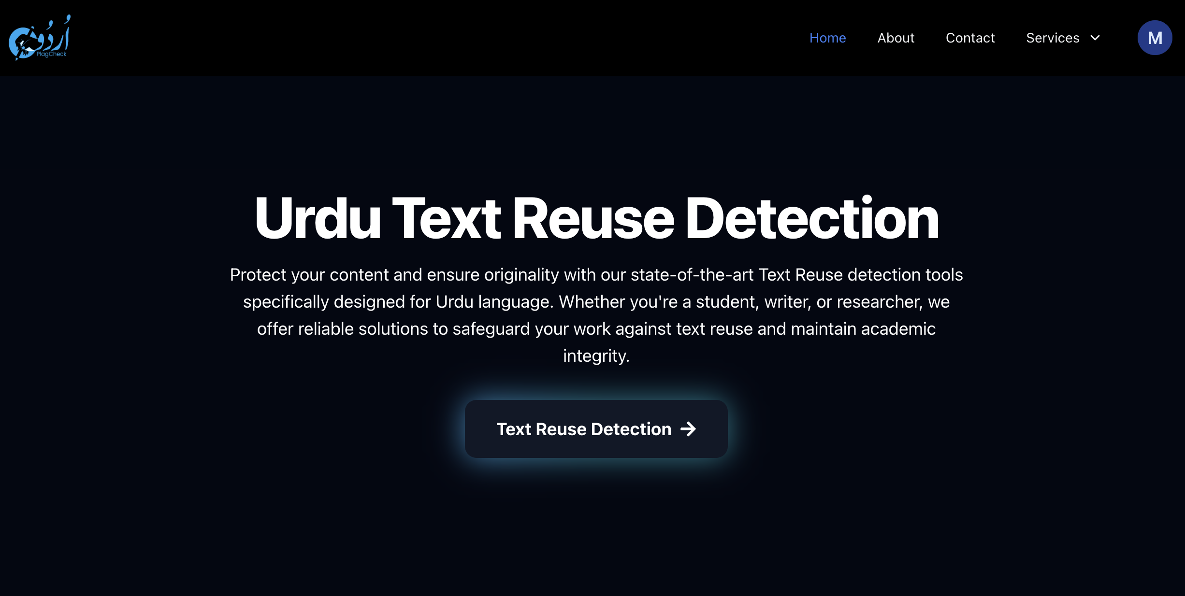
Web Application Features
Text Reuse detection
1
2
API Service
Allow Individuals to generate API to integrate functionality in their own system.
Allow the user to input two Urdu sentences, and Output predicted Urdu Text Reuse type.
Report Generation
Admin dashboard
3
4
Allow Administrator to manage all modules of web Application using Dashboard such as Authentication, Logs, Queries.
Allow user to generate Detection report and export them in PDF
Notes:
University law

Slide 28






Technology Used
Node JS
Tailwind CSS
React JS
Fast API
NEXT JS
Mongo DB
Notes:
Pydantic Node.js
Enables server-side JavaScript execution for building scalable backend APIs and handling asynchronous operations.
Tailwind CSS
Provides a utility-first CSS framework for rapidly building custom, responsive user interfaces
.React.js
Facilitates the creation of dynamic, component-based user interfaces for a seamless frontend experience.
FastAPI
(If used) Delivers high-performance, easy-to-build RESTful APIs with automatic documentation in Python.
Next.js
Combines server-side rendering, static site generation, and routing for optimized React web applications.
MongoDB
Offers a flexible, document-oriented NoSQL database for efficiently storing and retrieving application data.

Slide 29
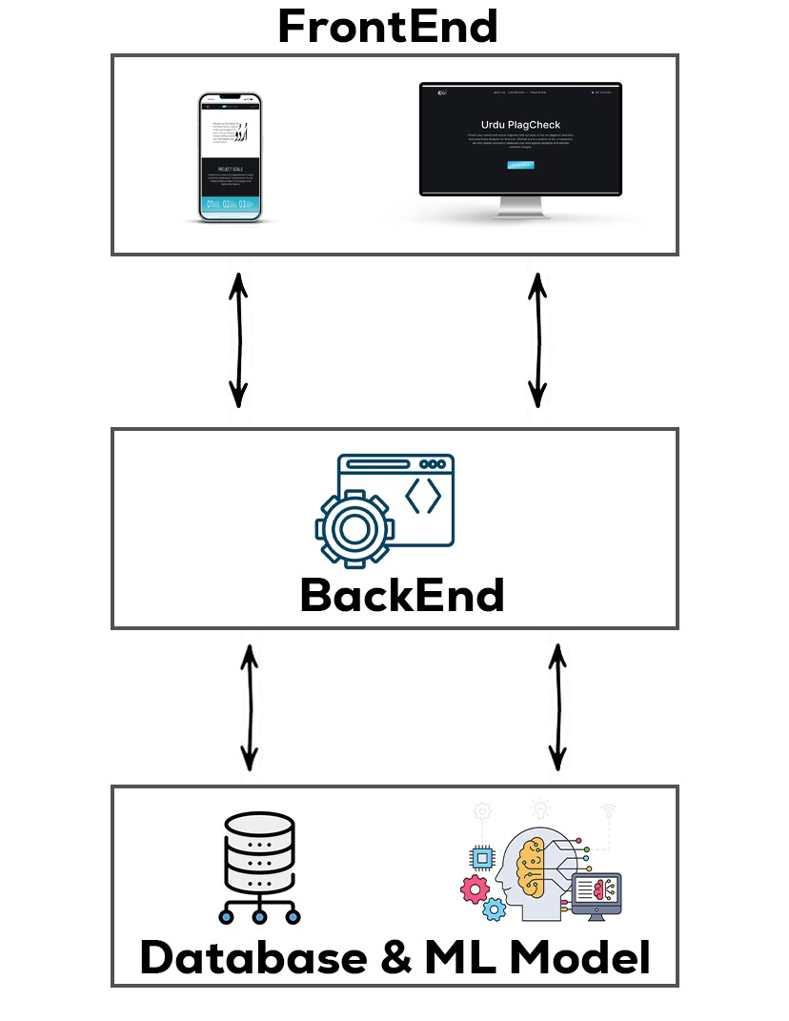

System Architecture
MongoDB
Stores user data, logs, reports, and other relevant information.
Node JS
Acts as the main server handling client requests and communicate with others server
Python Server
Handle AI related task such as text detection and return response to Node Server
Notes:
pydantic

Slide 30
Website Application
Web Application Demo
http://urduplagdetect.vercel.app

Slide 31
